Slide 1
Mendelian Randomization
USC Social Science Genetics Journal Club 4th December 2020
Neil Davies, neil.davies@bristol.ac.uk
Medical Research Council Integrative Epidemiology Unit, Bristol Medical School, University of Bristol, BS8 2BN, United Kingdom.
K.G. Jebsen Center for Genetic Epidemiology, Department of Public Health and Nursing, NTNU, Norwegian University of Science and Technology, Norway.

Slide 2
Questions very welcome!
Please feel free to interrupt at any time, I’m happy to clarify, discuss, debate, whatever.

Slide 3
Overview
Introduction to Mendelian randomization (genetic IVs)
MR of education using unrelateds
Family based designs
Simulations
Empirical example: The effects of height and BMI on education, blood pressure and diabetes
The Sibling GWAS

Slide 4
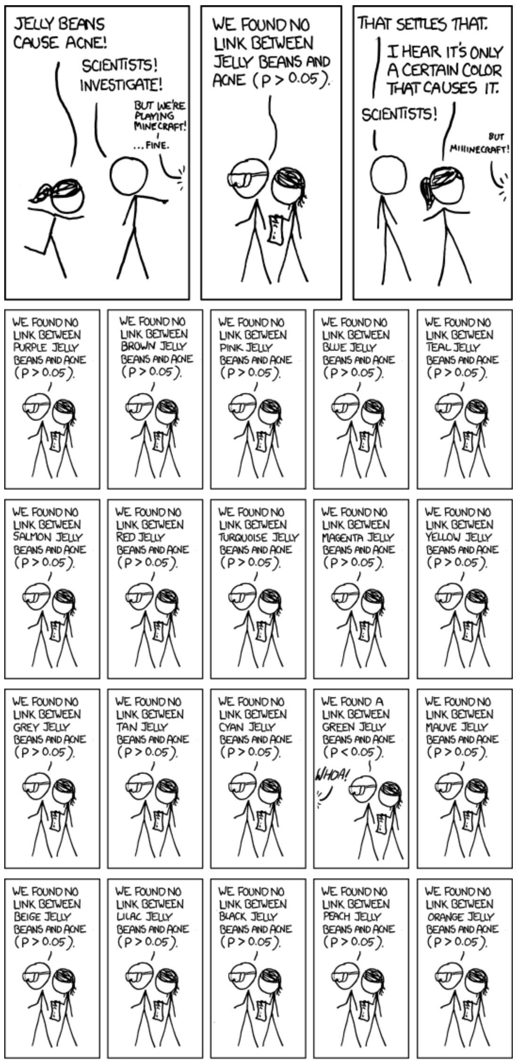
Why classical epidemiology failed
A step-by-step guide to classical epidemiology
Get sample (e.g. civil servants, doctors, women)
Measure risk factor
Either estimate
Cross sectional associations with disease
Longitudinal associations with disease
Publish in NEJM
Spend $$$ in RCT, -> fails to replicate
Pick another risk factor

Slide 5
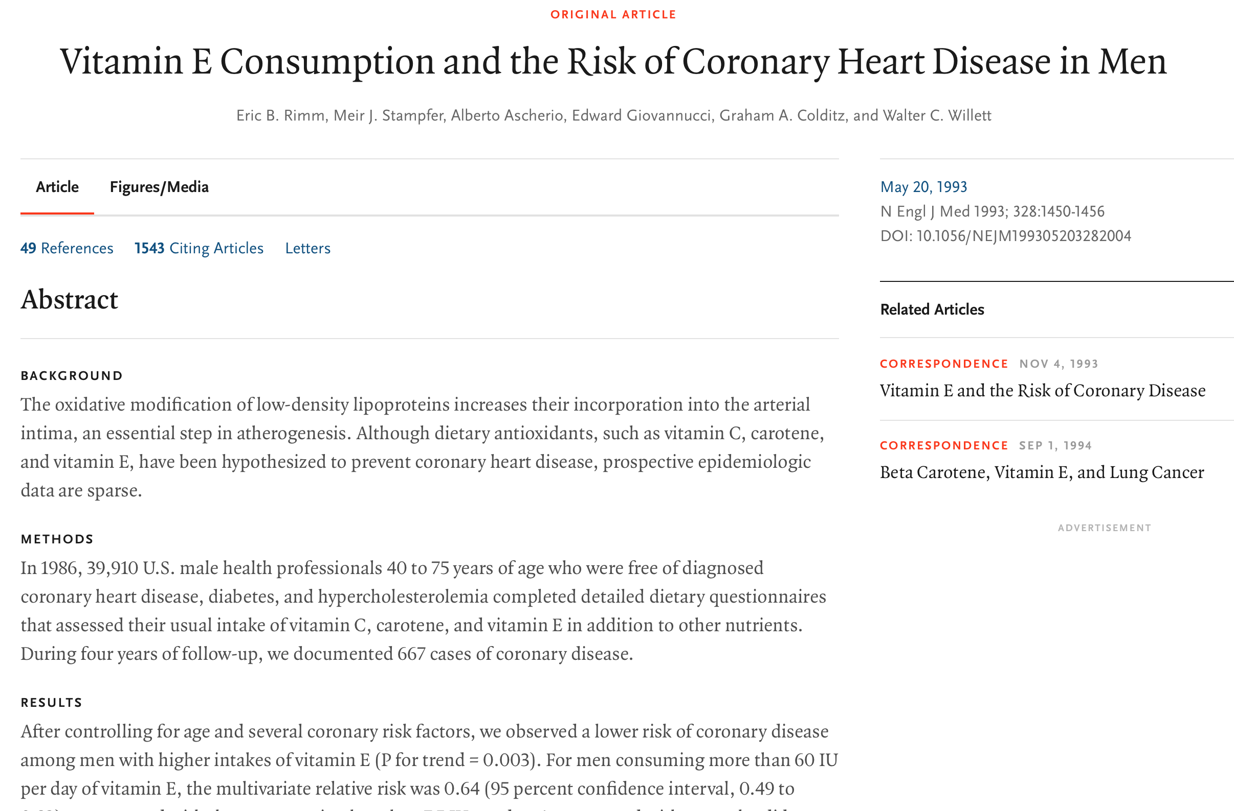
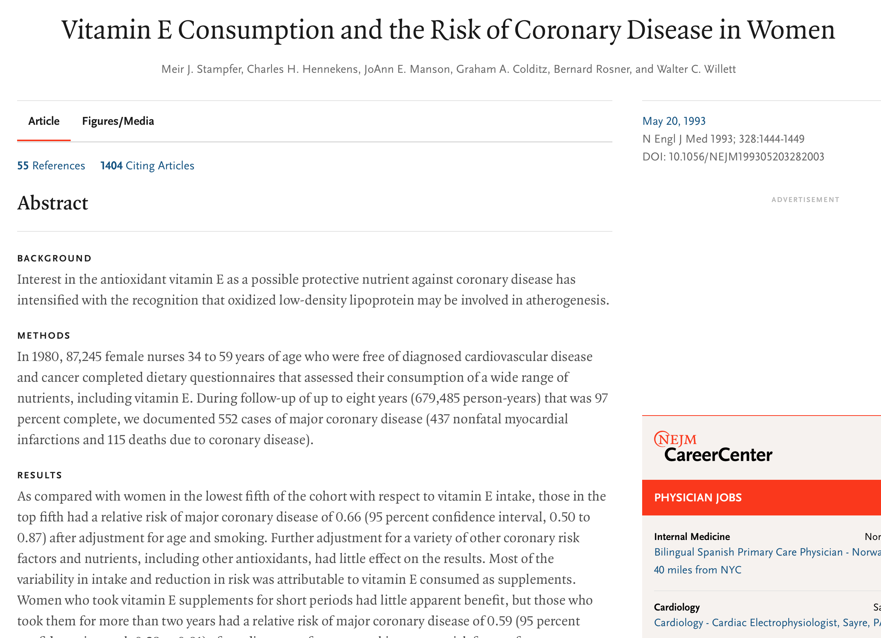
Does taking vit E reduce risk of coronary heart disease?

Slide 6
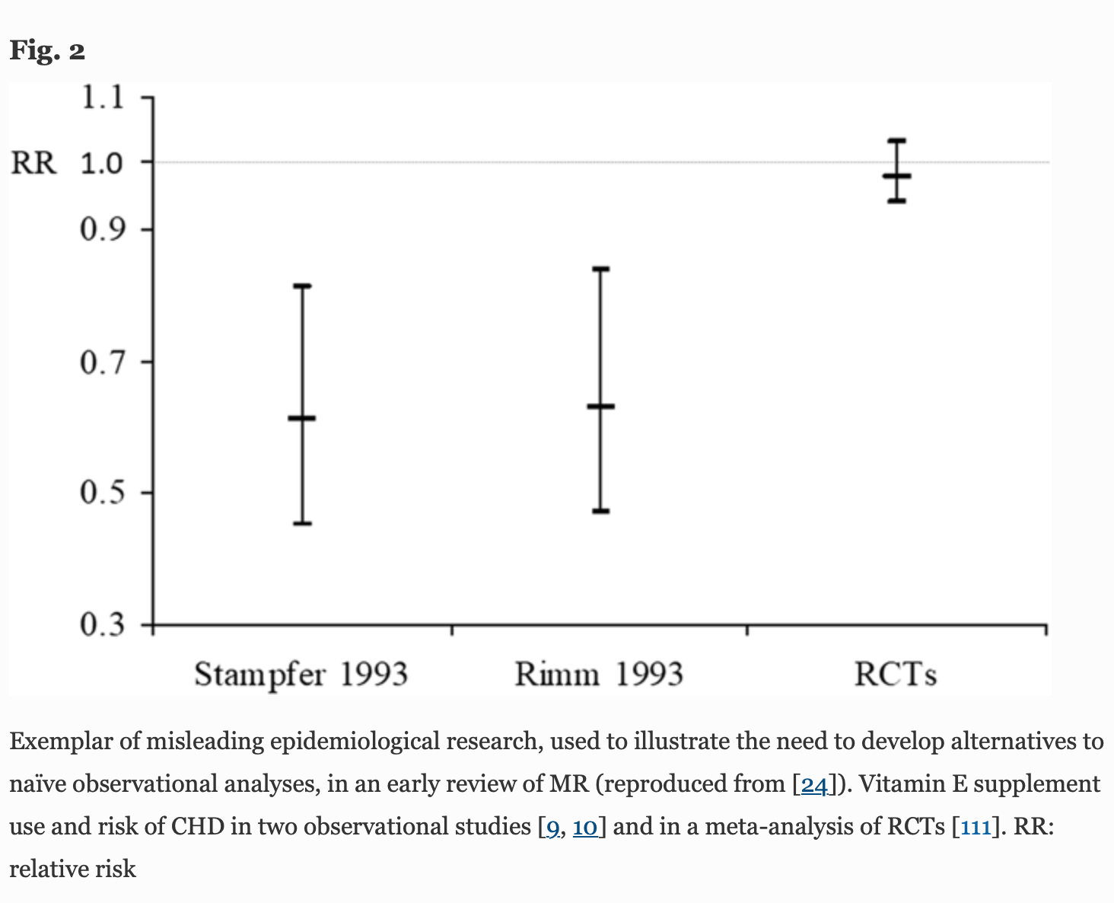
RCTs did not replicate this finding
Why? Endogeneity, confounding, and measurement error.
G. Davey Smith, M. V. Holmes, N. M. Davies, S. Ebrahim, Mendel’s laws, Mendelian randomization and causal inference in observational data: substantive and nomenclatural issues. Eur J Epidemiol. 35, 99–111 (2020).

Slide 7
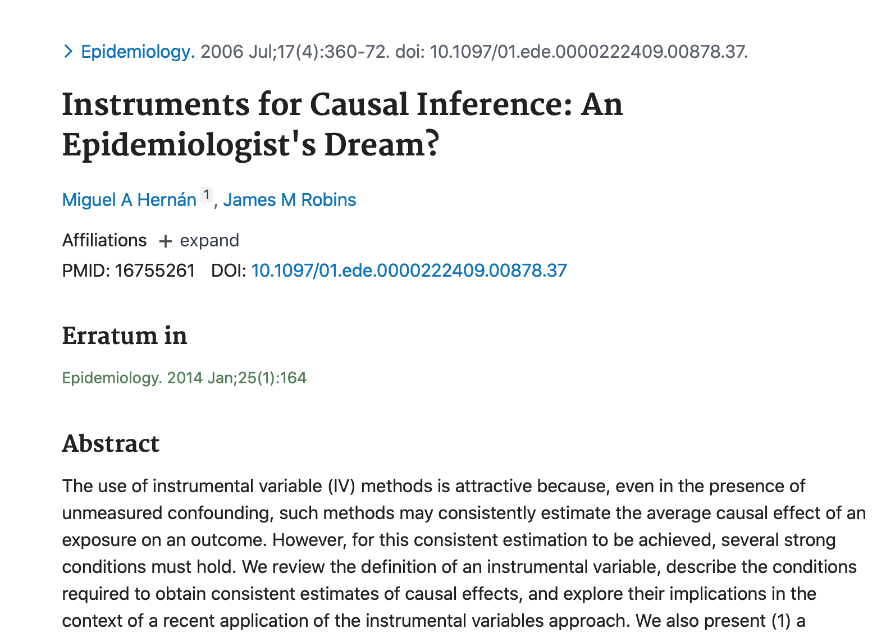
Econometrics to the rescue?
Classic epi – adjust measure confounders
Impossible to fully measure covariates
Need to estimate causal effects even if there are unmeasured confounders of the exposure-outcome relationship
Instrumental variables and natural experiments could help

Slide 8
The instrumental variable assumptions
The instrumental variable assumptions:
Relevance: The instrument associates with the exposure of interest
Independence: There are no confounders of the instrument-outcome association
Exclusion restriction: The instrument only affects the outcome via the exposure
Often conflated in economics papers
Confounder
Instrument
Exposure
Outcome
P. Wright, Letter from Philip Wright to Sewall Wright, 4 March 1926., (available at https://ase.tufts.edu/economics/documents/wrightPhilipAndSewall.pdf).
J. D. Angrist, G. W. Imbens, D. B. Rubin, Identification of causal effects using instrumental variables. J Am Stat Assoc. 91, 444–455 (1996).
J. Pearl, Causality: models, reasoning, and inference (Cambridge University Press, Cambridge, U.K. ; New York, 2000).
M. A. Hernán, J. Robins, Instruments for causal inference: an epidemiologist’s dream? Epidemiology. 17, 360–372 (2006).
and many, many others……

Slide 9
Mendelian randomization=Genetic lotteries
DNA is randomly transmitted from parents to offspring
Germline DNA is not affected by the environment
The human genome:
~3 billion base pairs (A, C, G, or T)
Over 650 million variants
15 million common variants (minor allele frequency >1%)
Sequencing vs genotyping
M. Katan, Apoupoprotein E Isoforms, Serum Cholesterol, And Cancer. The Lancet. 327, 507–508 (1986).

Slide 10
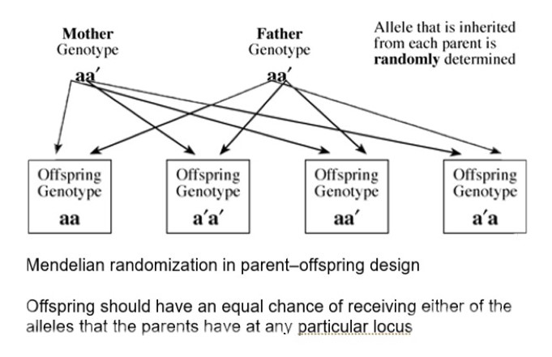
Random genetic inheritance: IVs from the masses
Genetic variants
Are a point in the genome that differs across the population
A common type of variant is single nucleotide polymorphisms (SNPs)
SNPs have one or more alleles
A conception offspring inherit at each SNP
One of mother’s two alleles
One of father’s two alleles
Reverse causation impossible.
Literal random inheritance of variants at
each loci within families
G. Davey Smith, S. Ebrahim, “Mendelian randomization”: can genetic epidemiology contribute to understanding environmental determinants of disease? Int J Epidemiol. 32, 1–22 (2003).

Slide 11
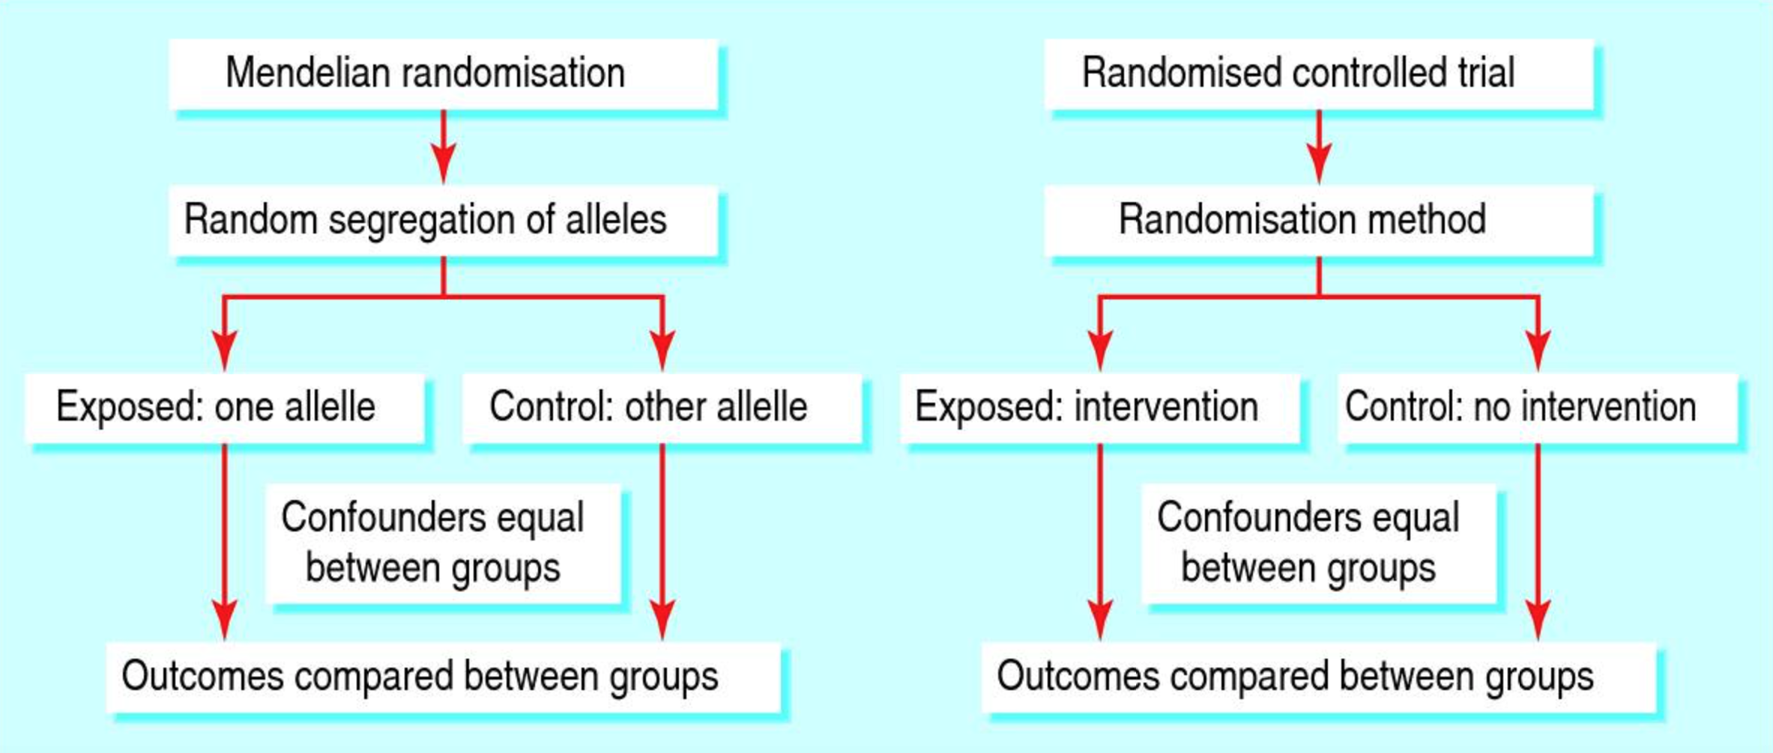
Nature’s randomized trials
G. Davey Smith, S. Ebrahim, What can mendelian randomisation tell us about modifiable behavioural and environmental exposures? BMJ. 330, 1076–1079 (2005).

Slide 12
Genetic variants as instrumental variables
The instrumental variable assumptions:
Relevance: SNPs associate with risk factors
Independence: SNPs are randomly allocated at conception
Exclusion restriction: SNPs tend to be inherited independently of SNPs for other traits (Mendel’s law of independent assortment)
Confounder
BMI SNPs
BMI
Education
G. Davey Smith, D. A. Lawlor, R. Harbord, N. Timpson, I. Day, S. Ebrahim, Clustered environments and randomized genes: a fundamental distinction between conventional and genetic epidemiology. PLoS Med. 4, e352 (2007).

Slide 13
Mendelian randomization: a step-by-step guide
Define hypothesis
E.g. does BMI affect educational attainment?
Select genetic variants from GWAS
which SNPs associate with BMI? Clump + threshold at p<5×10⁻⁰⁸
Estimate effect of exposure on outcome
One sample IV estimators, 2SLS, structural mean models, weak instrument robust methods, polygenic scores
Two-sample instrumental variable estimators
Pleiotropy robust methods - IVW, MR-Egger, weighted median
Sensitivity analyses
N. M. Davies, M. V. Holmes, G. Davey Smith, Reading Mendelian randomisation studies: a guide, glossary, and checklist for clinicians. BMJ, k601 (2018).
G. Hemani, J. Bowden, G. Davey Smith, Evaluating the potential role of pleiotropy in Mendelian randomization studies. Human Molecular Genetics. 27, R195–R208 (2018).

Slide 14
Genome-wide association studies (GWAS)
Estimate association between phenotype and SNPs across the genome
Up to 40 million variants
Linear or logistic regression
Covariates
Sex
Age
Principal components of genetic variation (PCs)
Samples of unrelated individuals (less than 3rd degree relatives)
Large databases of GWAS estimates available (e.g. MR-Base)
G. Hemani, J. Zheng, B. Elsworth, K. H. Wade, V. Haberland, D. Baird, C. Laurin, S. Burgess, J. Bowden, R. Langdon, V. Y. Tan, J. Yarmolinsky, H. A. Shihab, N. J. Timpson, D. M. Evans, C. Relton, R. M. Martin, G. Davey Smith, T. R. Gaunt, P. C. Haycock, The MR-Base platform supports systematic causal inference across the human phenome. eLife. 7 (2018), doi:10.7554/eLife.34408.

Slide 15
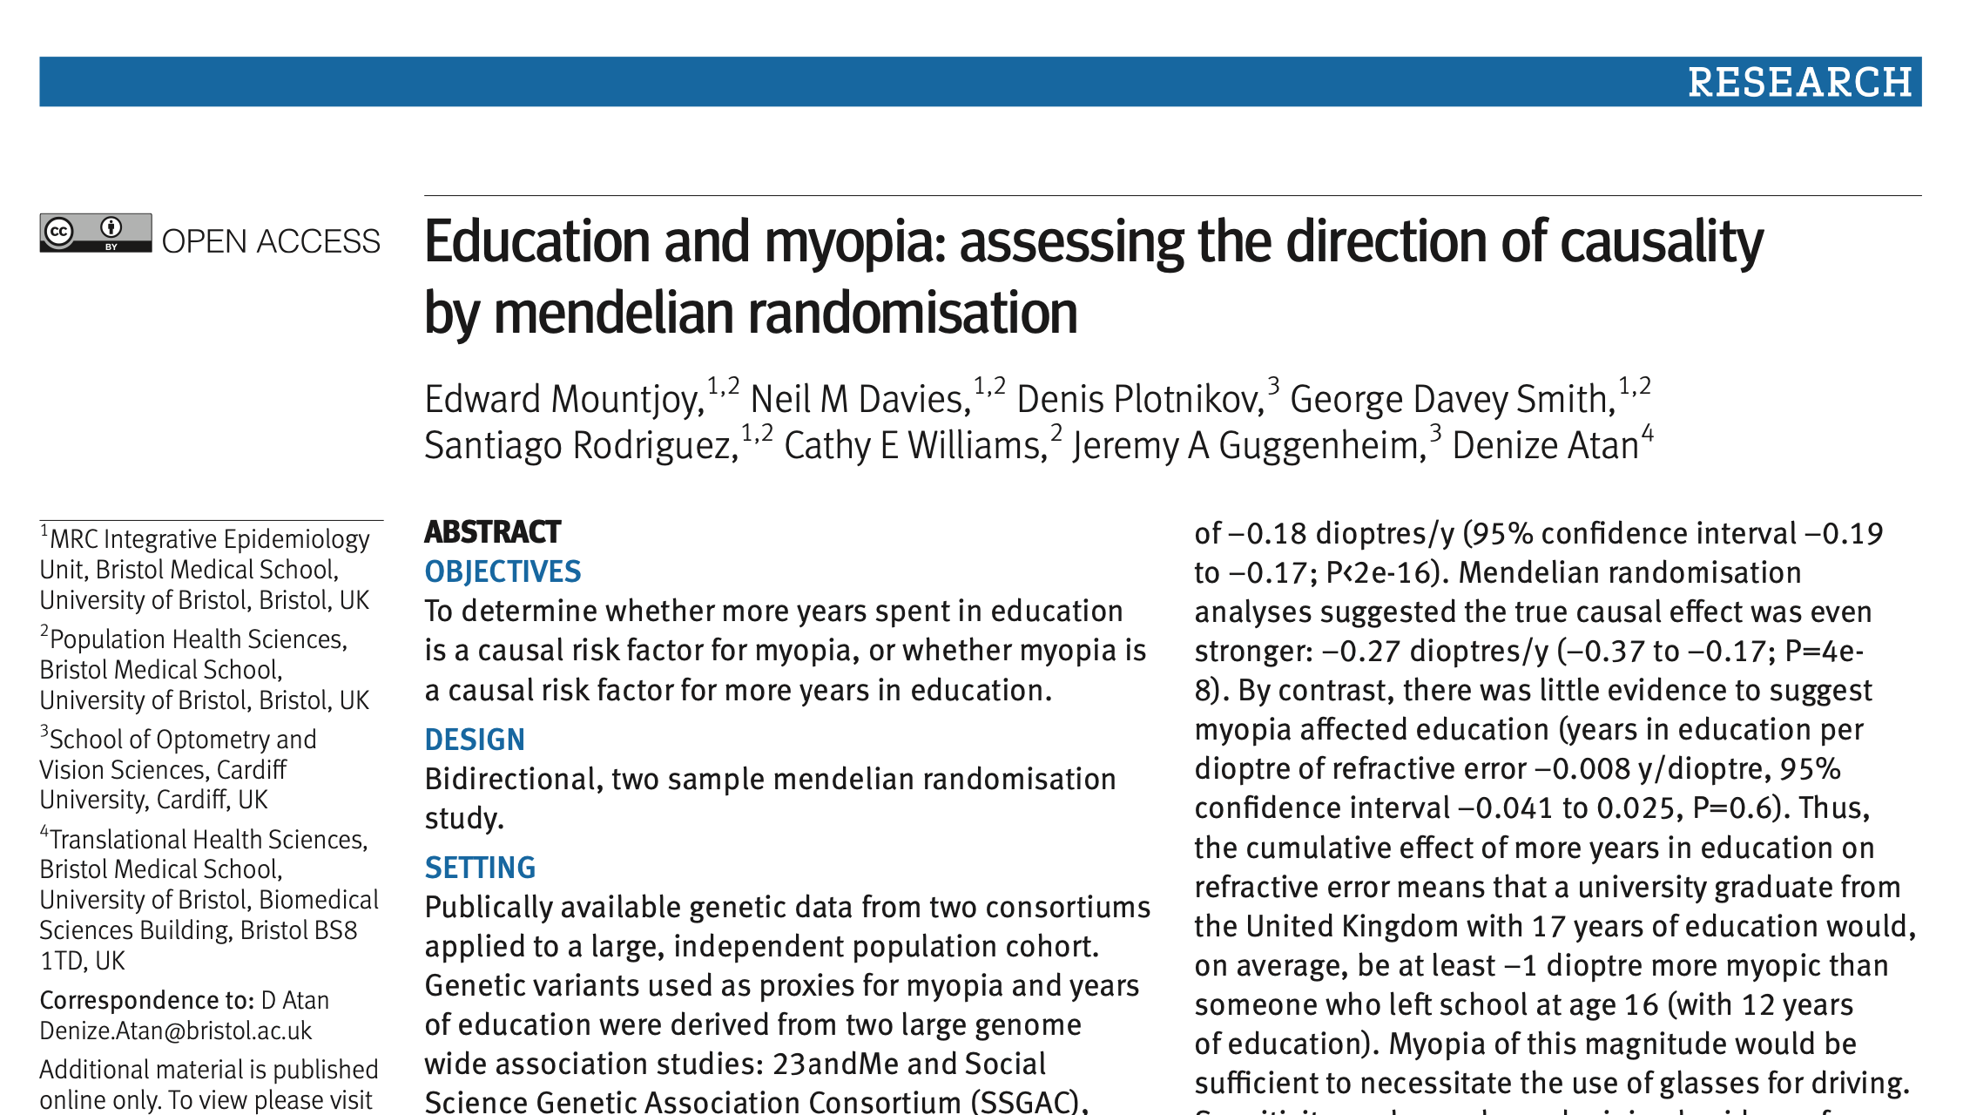
Confounder
Confounder
Myopia associated SNPs
Education associated SNPs
Education
Myopia
Myopia
Educational attainment

Slide 16
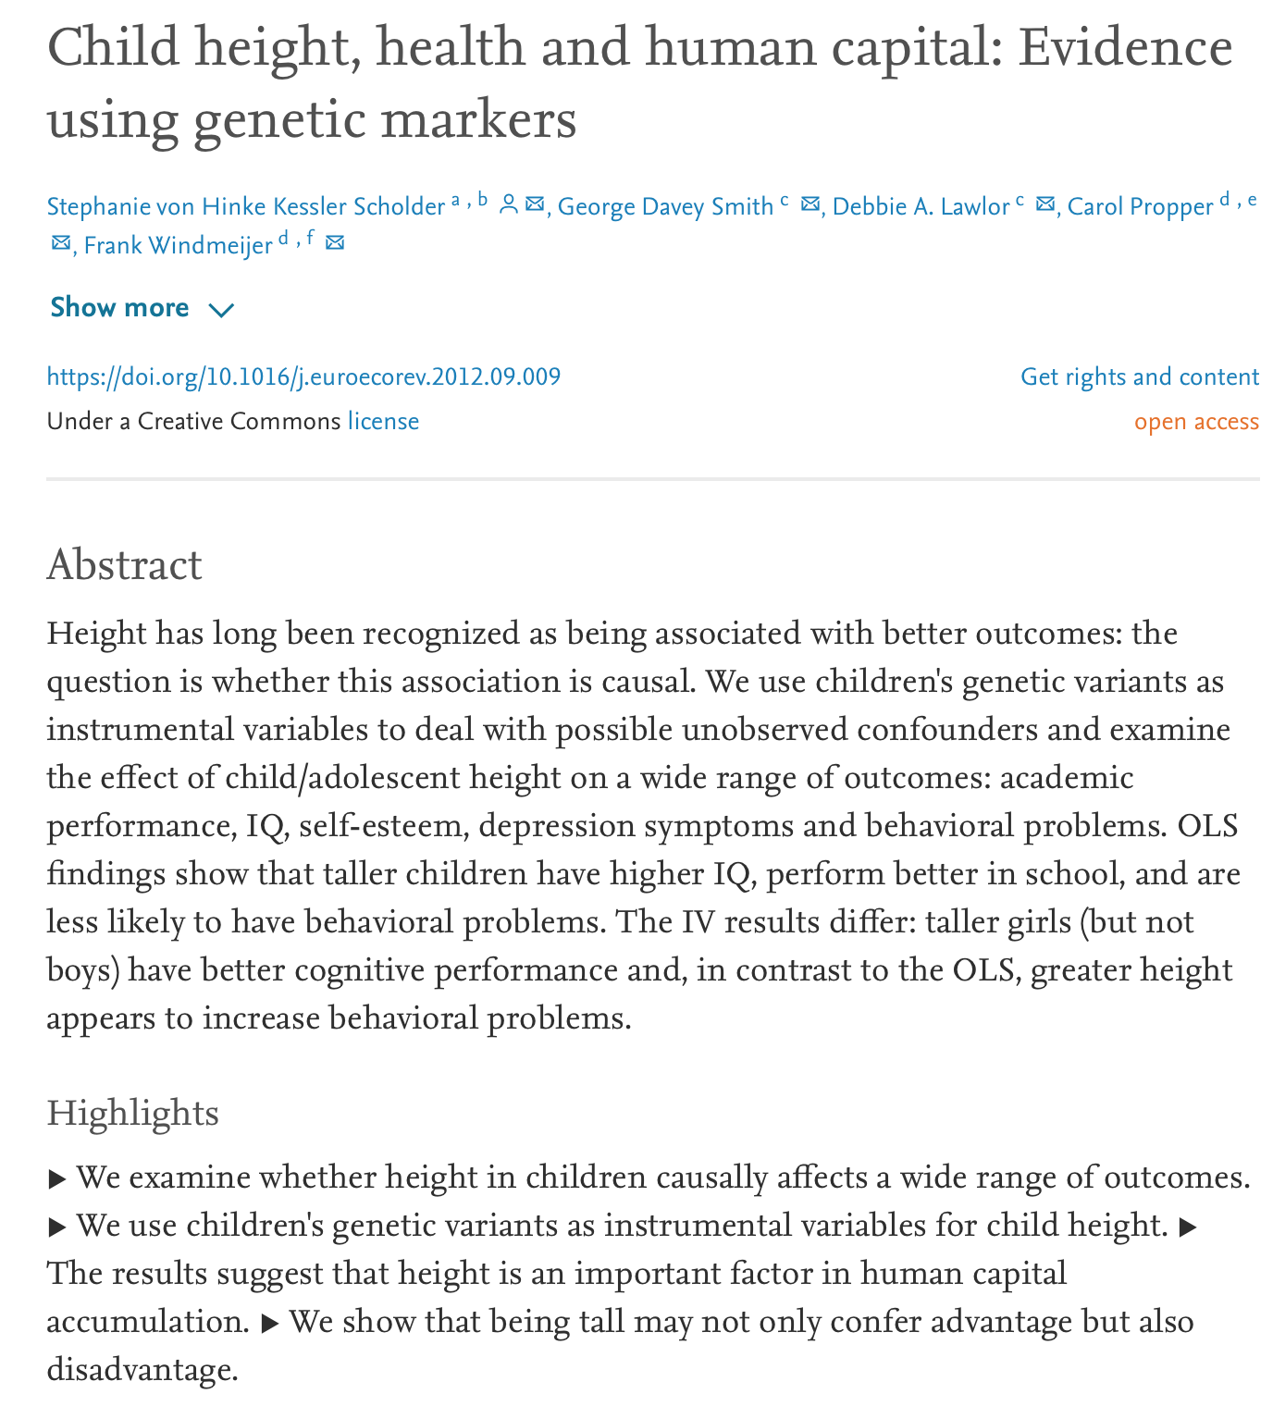
ALSPAC, unrelated individuals,
MR suggests height affects IQ and academic attainment.

Slide 17
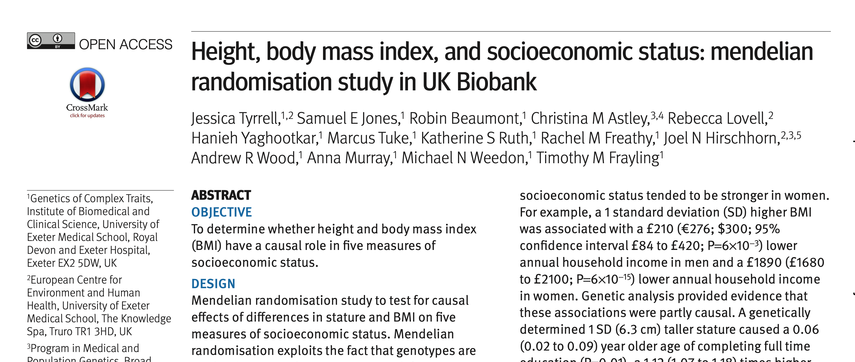
UK Biobank, unrelated individuals – MR suggests BMI/height affects education.

Slide 18
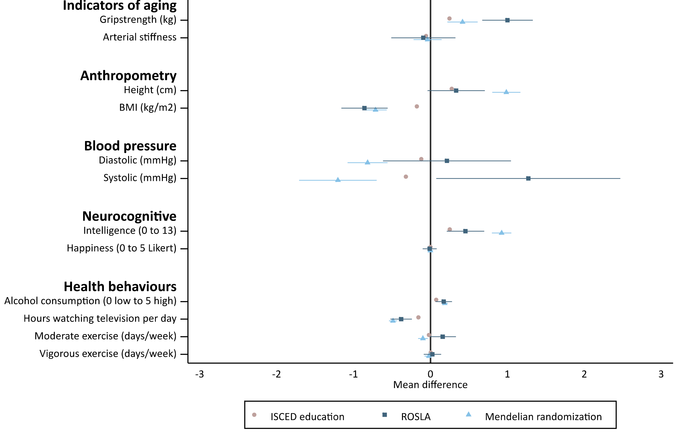
Comparison of ROSLA and MR estimates of effect of education on a range of phenotypes in the UK Biobank.
MR in unrelated individuals suggests education affects height.
N. M. Davies, M. Dickson, G. Davey Smith, F. Windmeijer, G. J. van den Berg, The effect of education on adult mortality, health, and income: triangulating across genetic and policy reforms (2018), doi:10.1101/250068.

Slide 19
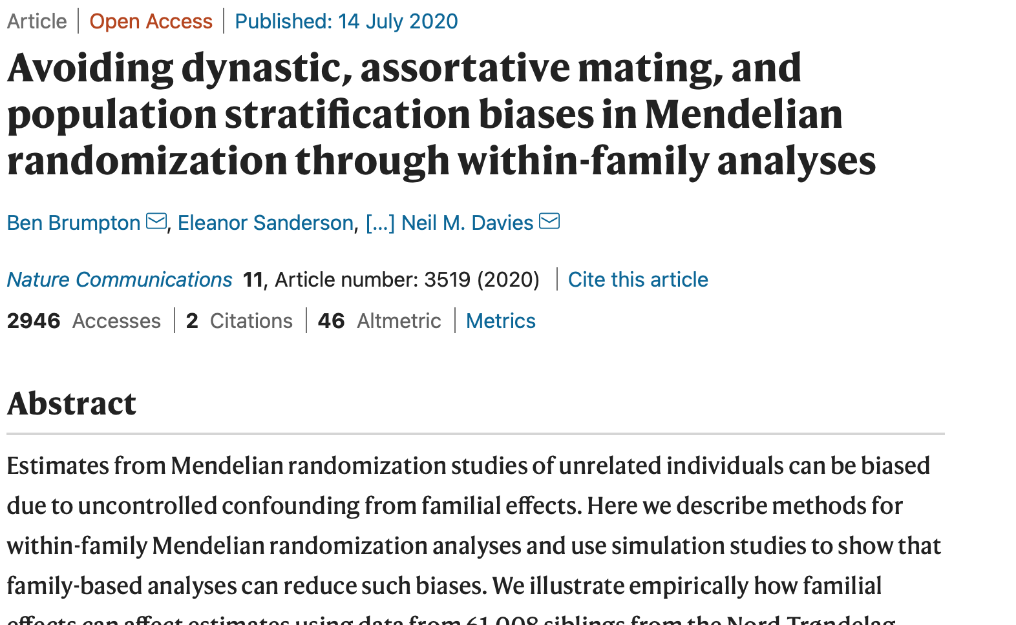

Slide 20
Limitations to conventional MR studies
Used samples of unrelated individuals
Controlled for standard covariates (age, sex, PCs)
Requires assumption that what is true within families is also true across populations, i.e. random distribution of height and BMI genetic variants
There are reasons to think this may not hold:
Fine scale population structure (Haworth et al 2019, Abdellaoui et al 2019)
Dynastic effects (Plomin and Bergeman 1991)
Assortative mating (Wright 1921)
A. Abdellaoui, D. Hugh-Jones, L. Yengo, K. E. Kemper, M. G. Nivard, L. Veul, Y. Holtz, B. P. Zietsch, T. M. Frayling, N. R. Wray, J. Yang, K. J. H. Verweij, P. M. Visscher, Genetic correlates of social stratification in Great Britain. Nature Human Behaviour (2019), doi:10.1038/s41562-019-0757-5.
S. Haworth, R. Mitchell, L. Corbin, K. H. Wade, T. Dudding, A. Budu-Aggrey, D. Carslake, G. Hemani, L. Paternoster, G. D. Smith, N. Davies, D. J. Lawson, N. J. Timpson, Apparent latent structure within the UK Biobank sample has implications for epidemiological analysis. Nature Communications. 10 (2019), doi:10.1038/s41467-018-08219-1.
R. Plomin, C. S. Bergeman, The nature of nurture: Genetic influence on “environmental” measures. Behavioral and Brain Sciences. 14, 373–386 (1991).
S. Wright, Systems of Mating. III. Assortative Mating Based on Somatic Resemblance. Genetics. 6, 144–161 (1921).
N. M. Davies, L. J. Howe, B. Brumpton, A. Havdahl, D. M. Evans, G. Davey Smith, Within family Mendelian randomization studies. Human Molecular Genetics. 28, R170–R179 (2019).
L.-D. Hwang, N. M. Davies, N. M. Warrington, D. M. Evans, Integrating Family-Based and Mendelian Randomization Designs. Cold Spring Harb Perspect Med, a039503 (2020).

Slide 21
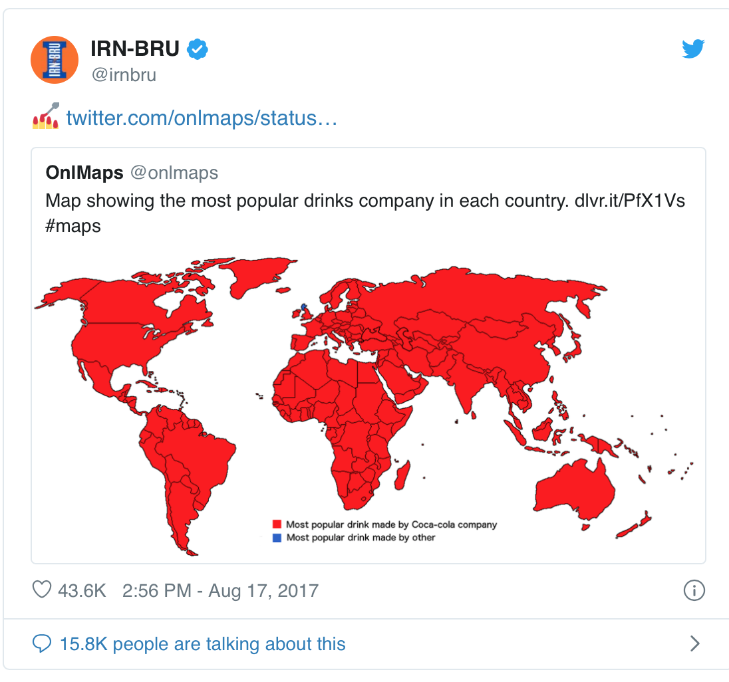

1) Fine scale population structure
Geographic or regional differences in allele frequency that relate to a trait of interest
For example:
People in Scotland drink more Irn Bru and have adverse health outcomes.
Some genetic variants will also have modestly different frequencies in Scotland
E.g. genetic variants associated with lactase persistence are more common in northern areas
This does not imply that Iru Bru causes adverse health outcomes
G. Davey Smith, D. A. Lawlor, N. J. Timpson, J. Baban, M. Kiessling, I. N. M. Day, S. Ebrahim, Lactase persistence-related genetic variant: population substructure and health outcomes. Eur J Hum Genet. 17, 357–367 (2009).
Notes:
If the allele frequency is higher in one subpopulation and the disease or trait frequecny are higher in that subpopulation. You will see an association between SNP and disease although this is not causal.

Slide 22
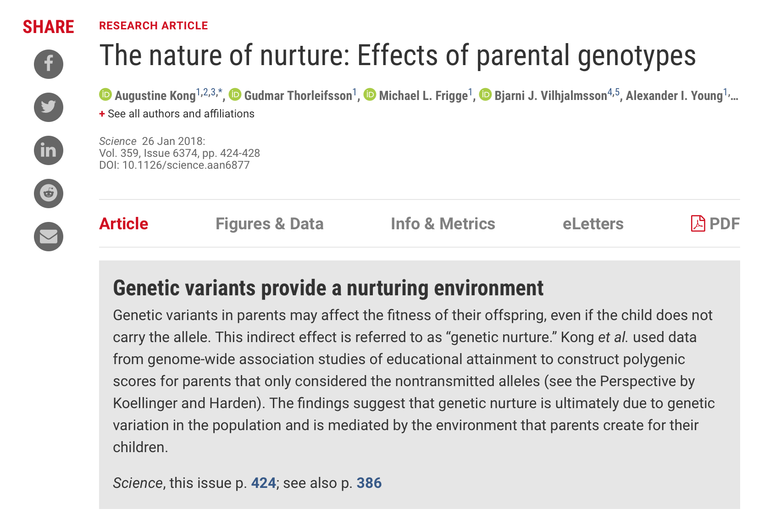
2) Dynastic effects
Family structure:
dynastic effects that occur when the expression of parent’s genotype directly affects the offspring phenotype.
For example, if more educated parents can afford tutoring for their children, leading to better educational outcomes for their offspring
Parents and offspring genotypes correlate 50%
Results in biased estimates of the effect of exposure in the offspring
Notes:
Dynastic effects can occur when the expression of parental genotype in the parents directly affects the offspring. For example, this could occur if more educated parents have higher incomes and are able to buy tutoring for their offspring.
1) Height > income of the parents > tutoring > education in the child

Slide 23
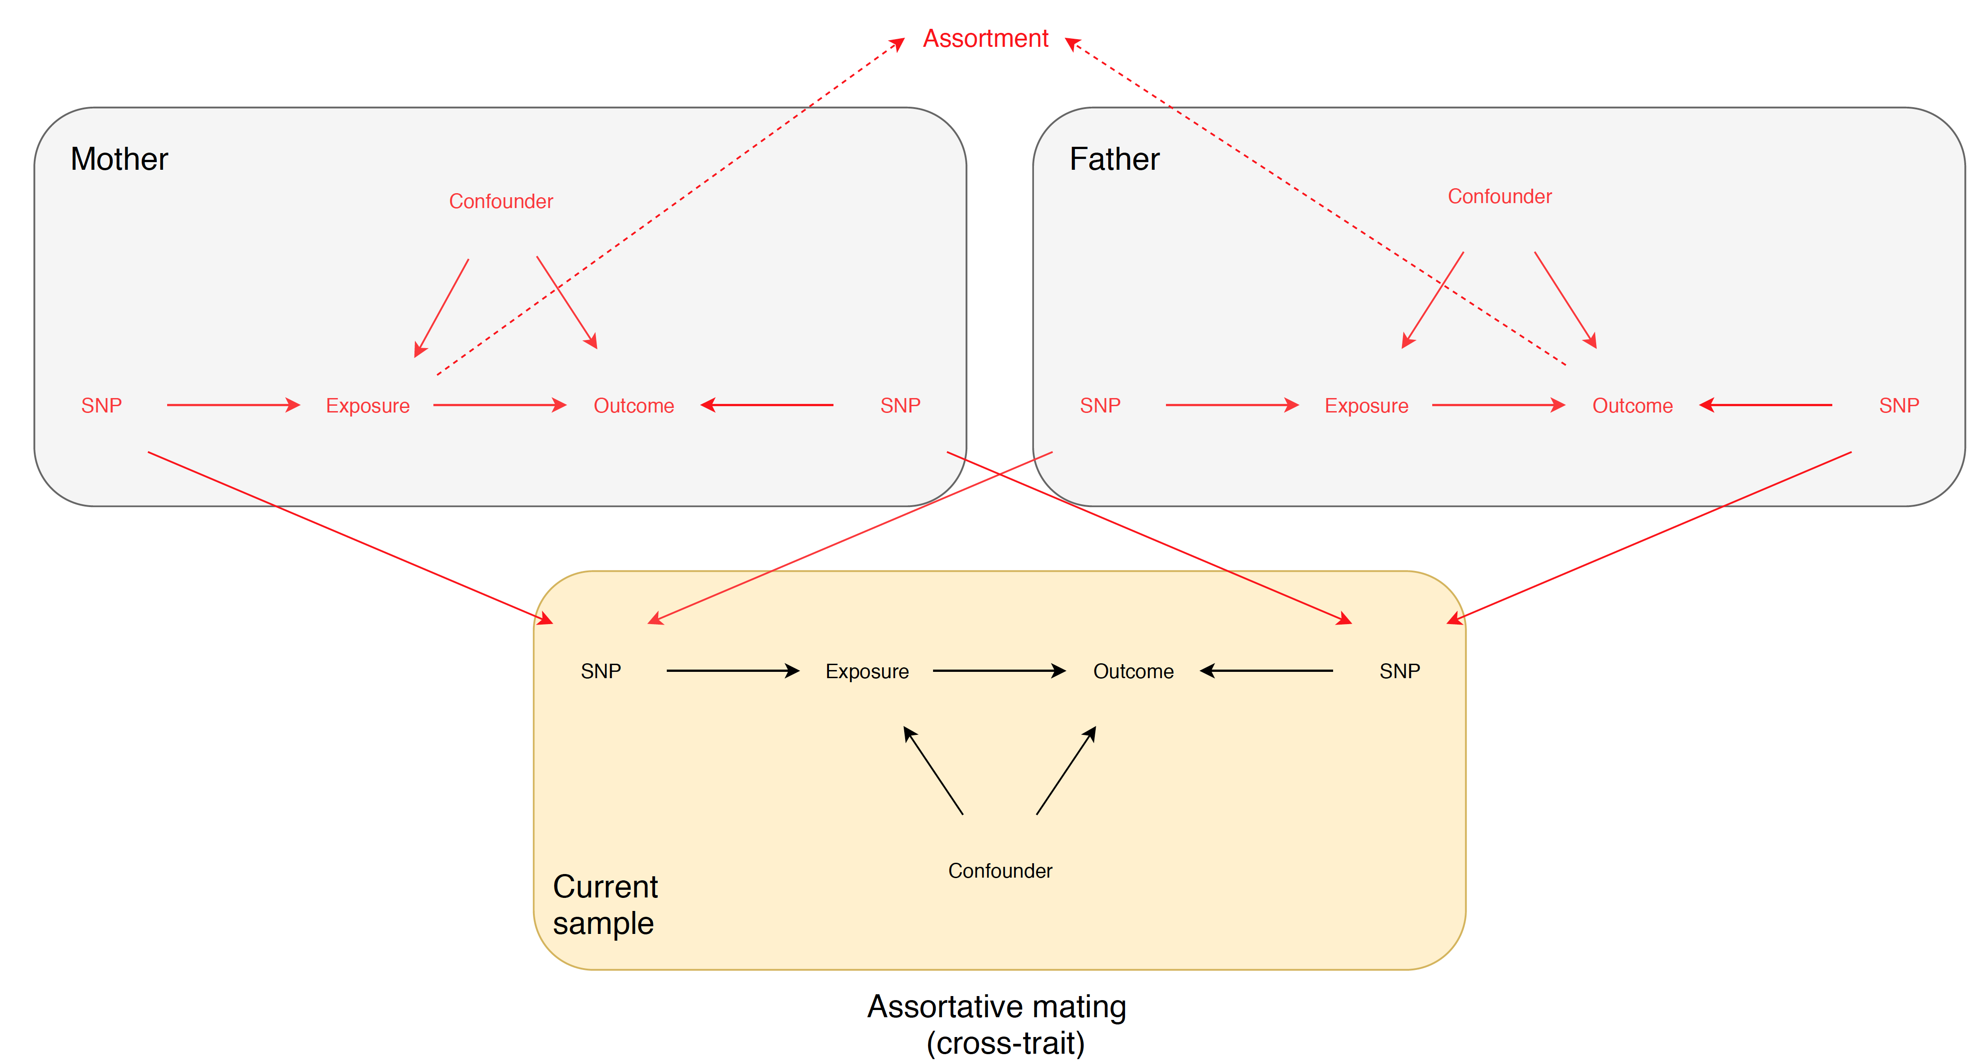
3) Assortative mating
Assortative mating - when individuals do not choose their partners at random but select someone who is more similar to them on particular characteristics than would be expected by chance.
Assortment on education, BMI and height
Causes bias in MR estimates
F. P. Hartwig, N. M. Davies, G. Davey Smith, Bias in Mendelian randomization due to assortative mating. Genetic Epidemiology. 42, 608–620 (2018).
Notes:
The bottom‐left panel illustrates cross‐trait assortative mating on X and Y by two thick lines: from mother's X to father's Y, and from mother's Y to father's X. In this situation, if X does not cause Y, the mother's GXand father's GY, and mother's GY and father's GX will be associated. If X does cause Y, then all parental genetic variables will associate.

Slide 24
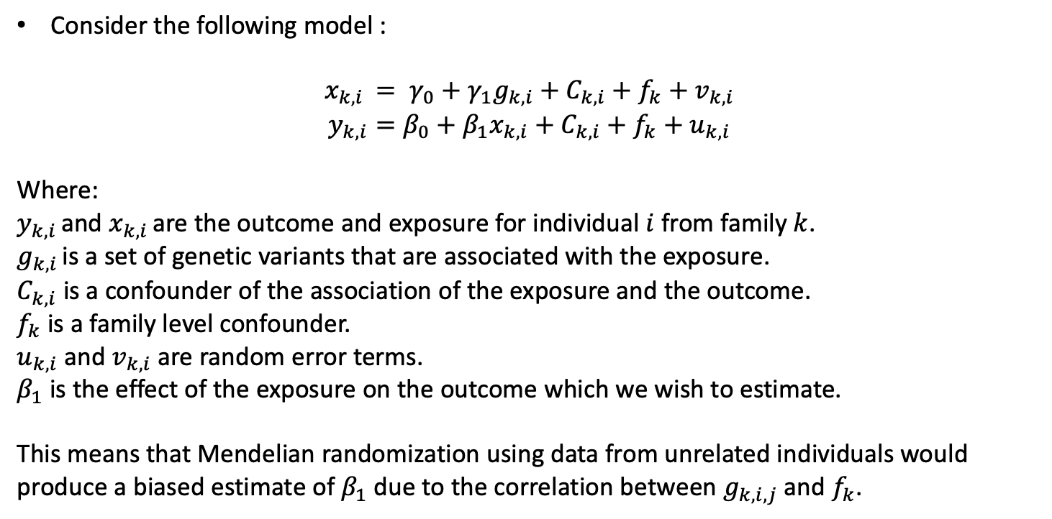
Econometric methods
Consider the following model :
$$x_{k,i }= γ_{0}+γ_{1}g_{k,i}+C_{k,i}+f_{k}+v_{k,i}$$
$$y_{k,i}=β_{0}+β_{1}x_{k,i}+C_{k,i}+f_{k}+u_{k,i}$$
Where:
$y_{k,i }$and $x_{k,i }$are the outcome and exposure for individual $i$ from family $k$.
$g_{k,i }$is a set of genetic variants that are associated with the exposure.
$C_{k,i}$ is a confounder of the association of the exposure and the outcome.
$f_{k}$ is a family level confounder.
$u_{k,i}$ and $v_{k,i}$ are random error terms.
$β_{1}$ is the effect of the exposure on the outcome which we wish to estimate.
This means that Mendelian randomization using data from unrelated individuals would produce a biased estimate of $β_{1}$ due to the correlation between $g_{k,i,j}$and $f_{k}$.
Notes:
$y_{k,i }$and $x_{k,i }$are the outcome and exposure for individual $i$ from family $k$.
$g_{k,i }$is a set of genetic variants that are associated with the exposure.
$C_{k,i}$ is a confounder of the association of the exposure and the outcome.
$f_{k}$ is a family level confounder.
$u_{k,i}$ and $v_{k,i}$ are correlated random error terms.
$β_{1}$ is the effect of the exposure on the outcome which we wish to estimate.

Slide 25
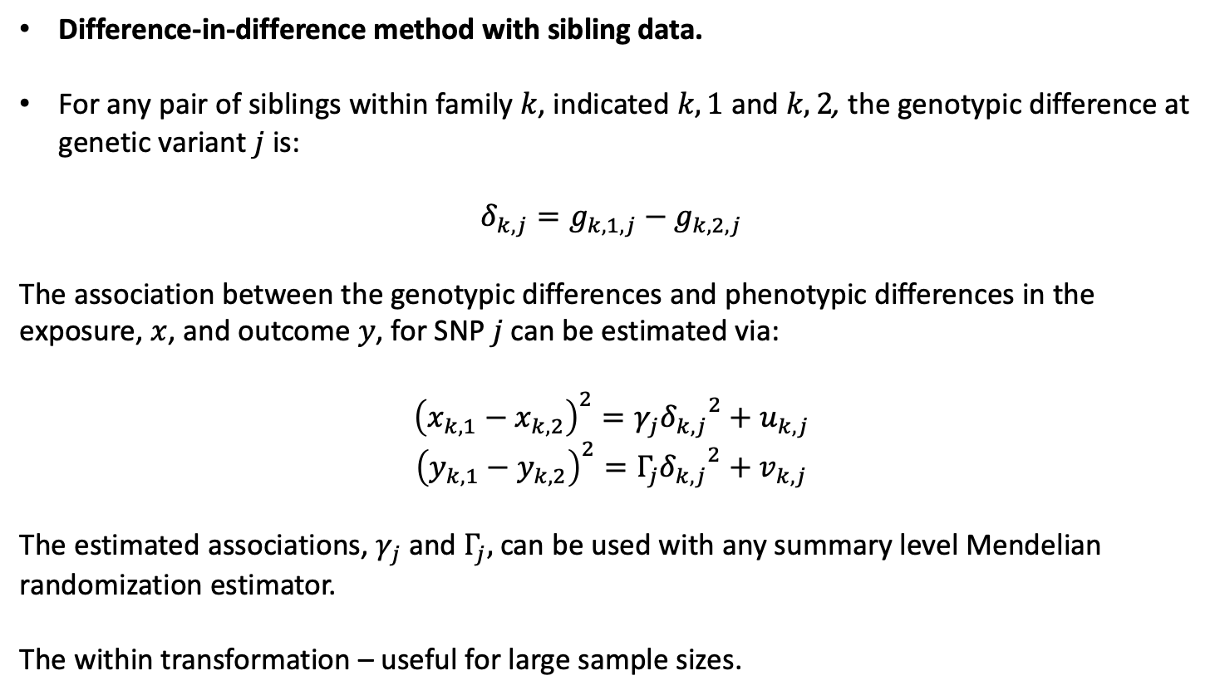
Econometric methods
Difference-in-difference method with sibling data.
For any pair of siblings within family $k$, indicated $k,1$ and $k,2$, the genotypic difference at genetic variant $j$ is:
$$δ_{k,j}=g_{k,1,j}−g_{k,2,j}$$
The association between the genotypic differences and phenotypic differences in the exposure, $x$, and outcome $y$, for SNP $j$ can be estimated via:
${\left(x_{k,1}−x_{k,2}\right)}^{2}=γ_{j}{δ_{k,j}}^{2}+u_{k,j}$
${\left(y_{k,1}−y_{k,2}\right)}^{2}=Γ_{j}{δ_{k,j}}^{2}+v_{k,j}$
The estimated associations, $γ_{j}$and $Γ_{j},$can be used with any summary level Mendelian randomization estimator.
The within transformation – useful for large sample sizes.
Notes:
$δ$=delta
Gamma (uppercase Γ, lowercase γ)

Slide 26
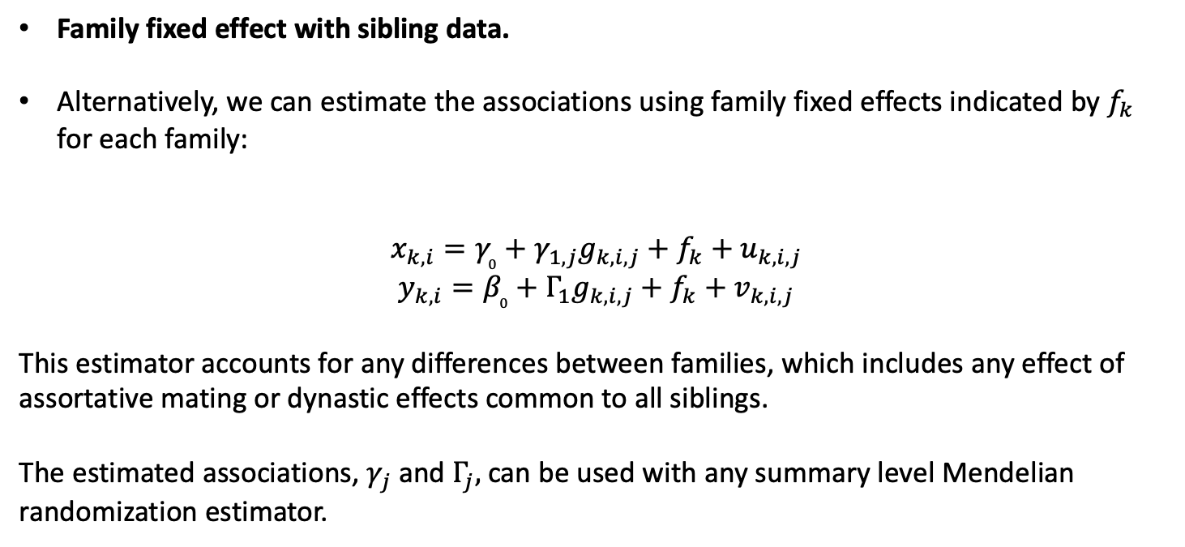
Econometric methods
Family fixed effect with sibling data.
Alternatively, we can estimate the associations using family fixed effects indicated by $f_{k}$ for each family:
$$x_{k,i}=γ_{0}+γ_{1,j}g_{k,i,j}+f_{k}+u_{k,i,j}$$
$$y_{k,i}=β_{0}+Γ_{1}g_{k,i,j}+f_{k}+v_{k,i,j}$$
This estimator accounts for any differences between families, which includes any effect of assortative mating or dynastic effects common to all siblings.
The estimated associations, $γ_{j}$and $Γ_{j},$can be used with any summary level Mendelian randomization estimator.
Notes:
$y_{k,i }$and $x_{k,i }$are the outcome and exposure for individual $i$ from family $k$.
$g_{k,i }$is a set of genetic variants that are associated with the exposure.
$C_{k,i}$ is a confounder of the association of the exposure and the outcome.
$f_{k}$ is a family level confounder.
$u_{k,i}$ and $v_{k,i}$ are correlated random error terms.
$β_{1}$ is the effect of the exposure on the outcome which we wish to estimate.

Slide 27
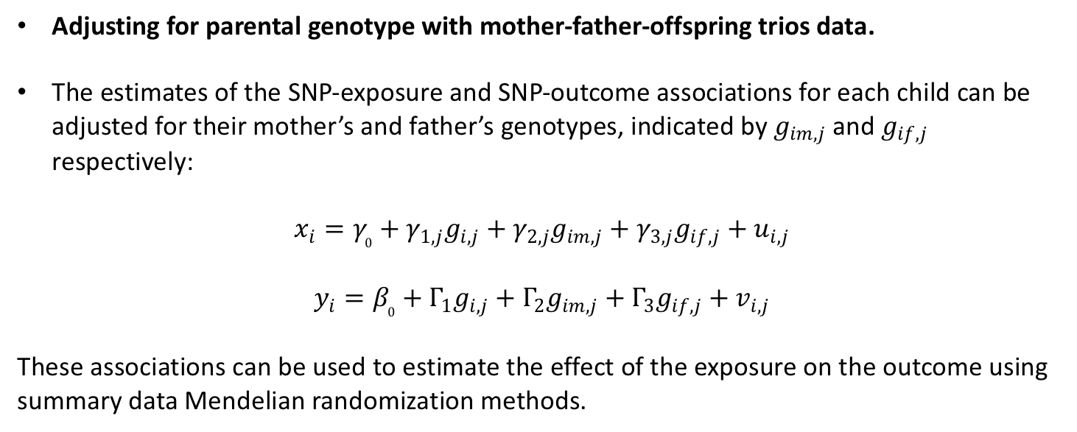
Econometric methods
Adjusting for parental genotype with mother-father-offspring trios data.
The estimates of the SNP-exposure and SNP-outcome associations for each child can be adjusted for their mother’s and father’s genotypes, indicated by $g_{im,j}$ and $g_{if,j}$ respectively:
$$x_{i}=γ_{0}+γ_{1,j}g_{i,j}+γ_{2,j}g_{im,j}+γ_{3,j}g_{if,j}+u_{i,j}$$
$$y_{i}=β_{0}+Γ_{1}g_{i,j}+Γ_{2}g_{im,j}+Γ_{3}g_{if,j}+v_{i,j}$$
These associations can be used to estimate the effect of the exposure on the outcome using summary data Mendelian randomization methods.

Slide 28
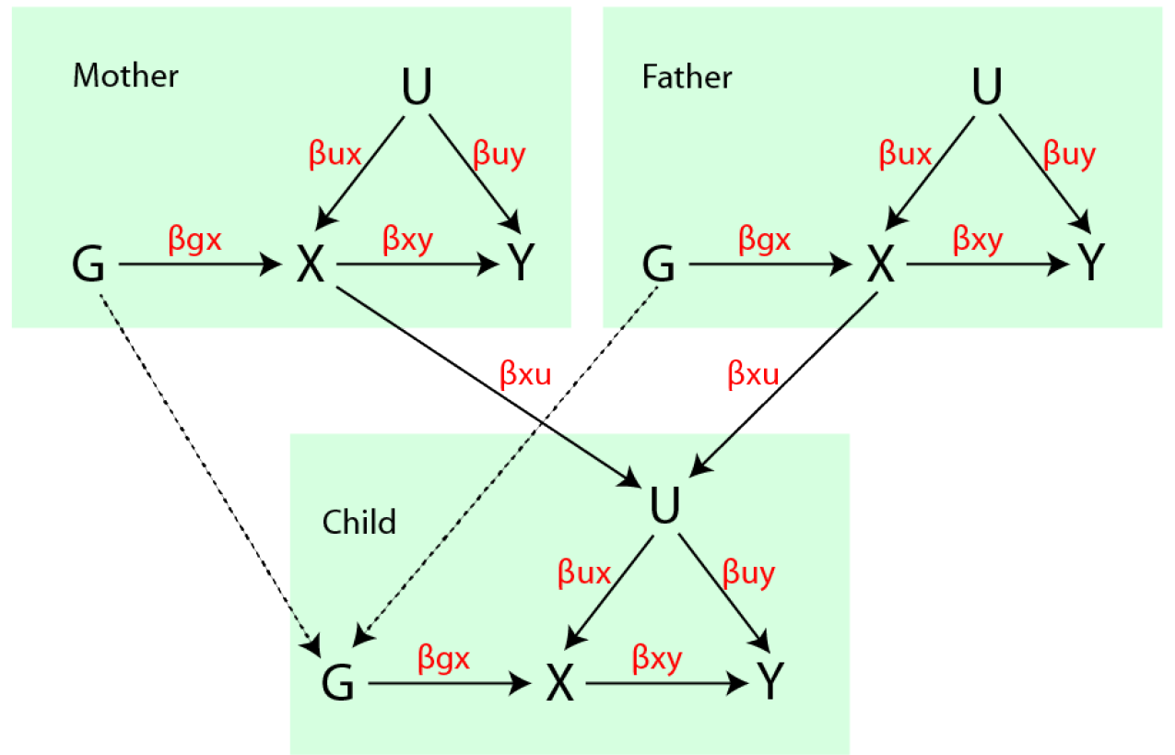
Methods
Simulations
SNP-exposure r2 = 0.05
Sample size = 10,000
90 independent SNPs
Simulation involves an influence of parental exposure influencing child’s confounder.

Slide 29
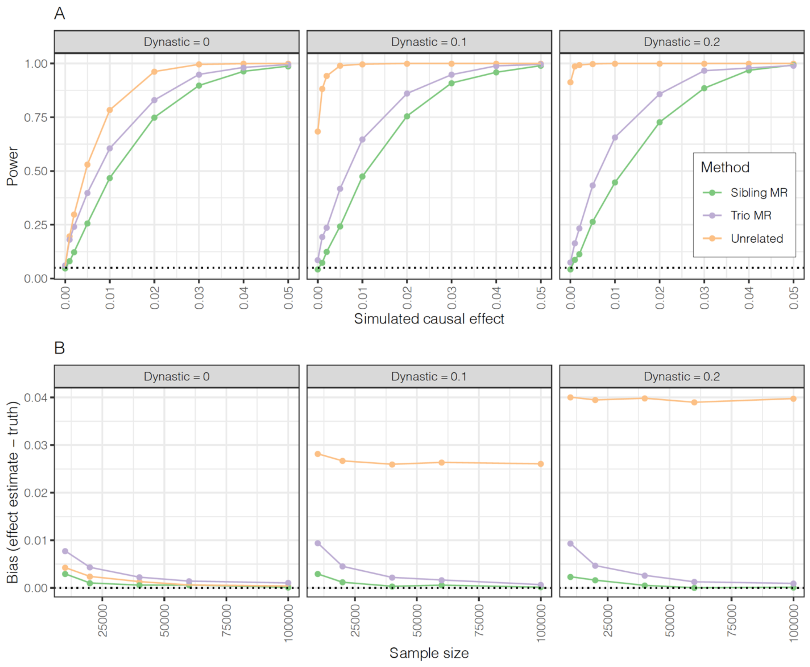
Results
Simulations
Bias occurs if there are dynastic effects. I.e. if the parents affect the offspring outcomes.
However, estimates from within-family designs are less substantially less powerful.
The simulations show how family structure can be exploited to control for the bias either using samples of siblings or mother-father-offspring trios.

Slide 30
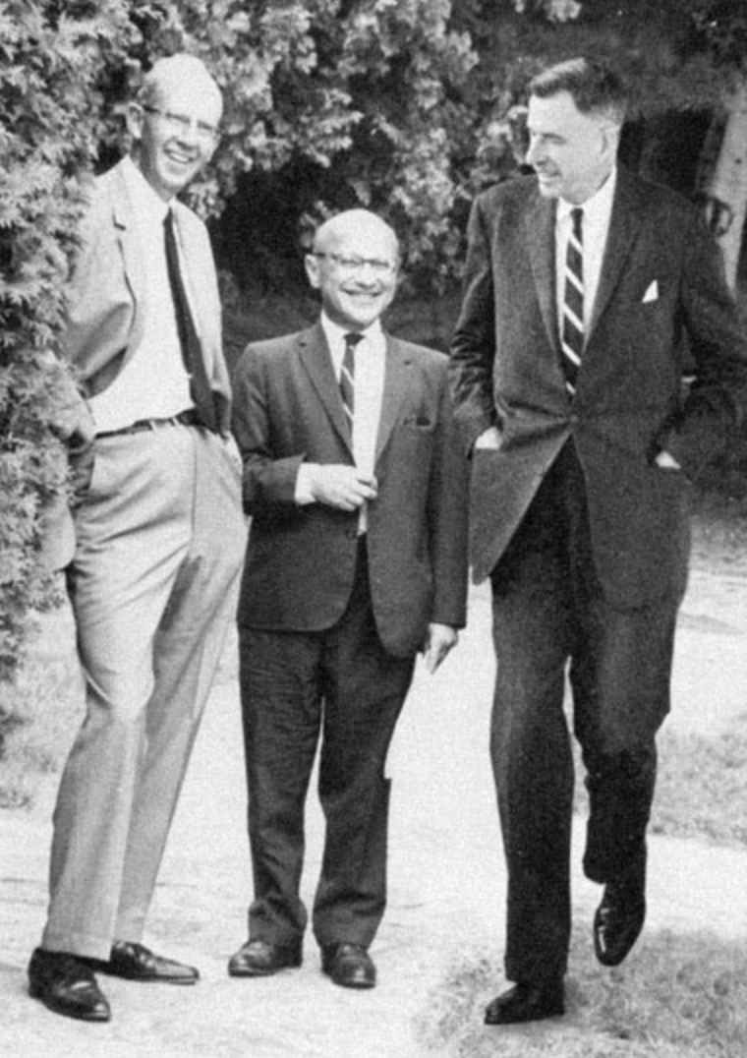
Empirical study
Hypotheses
What is the effect of BMI on
Diabetes
High blood pressure
Educational attainment
What is the effect height on
4. Educational attainment

Slide 31
Data
HUNT
HUNT > ~125,000 unique individuals (H1-3)> ~71,800 genotyped (H2-3) > ~24,000 unrelated (2nd degree) Europeans.
Genotyping - HumanCoreExome12 v1.0, HumanCoreExome12 v1.1 and UM HUNT Biobank v1.0 (n=516,608).
Imputation – merged reference panel constructed from the Haplotype Reference Consortium (HRC) panel (release version 1.1) and a local reference panel
Empirical study (HUNT+UKB)
HUNT2 > 65,237 participated > 56,374 genotyped > 53,288 complete data > 19,492 unrelated | 28,823 siblings > 13,103 families
UKBB > 503,317 participated > 370,180 met inclusion criteria > 33,642 siblings
Exposures and outcomes
Height, BMI > Education
BMI > Diabetes, Blood pressure
Replication: 23andMe 222,368 siblings

Slide 32
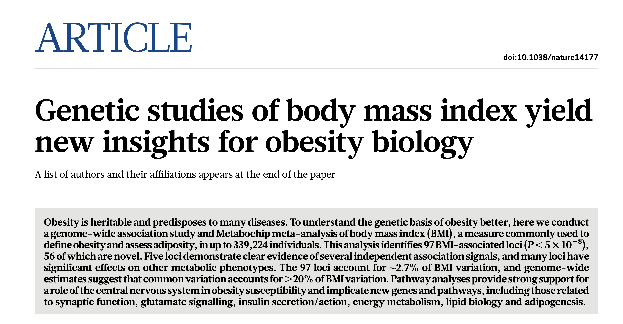
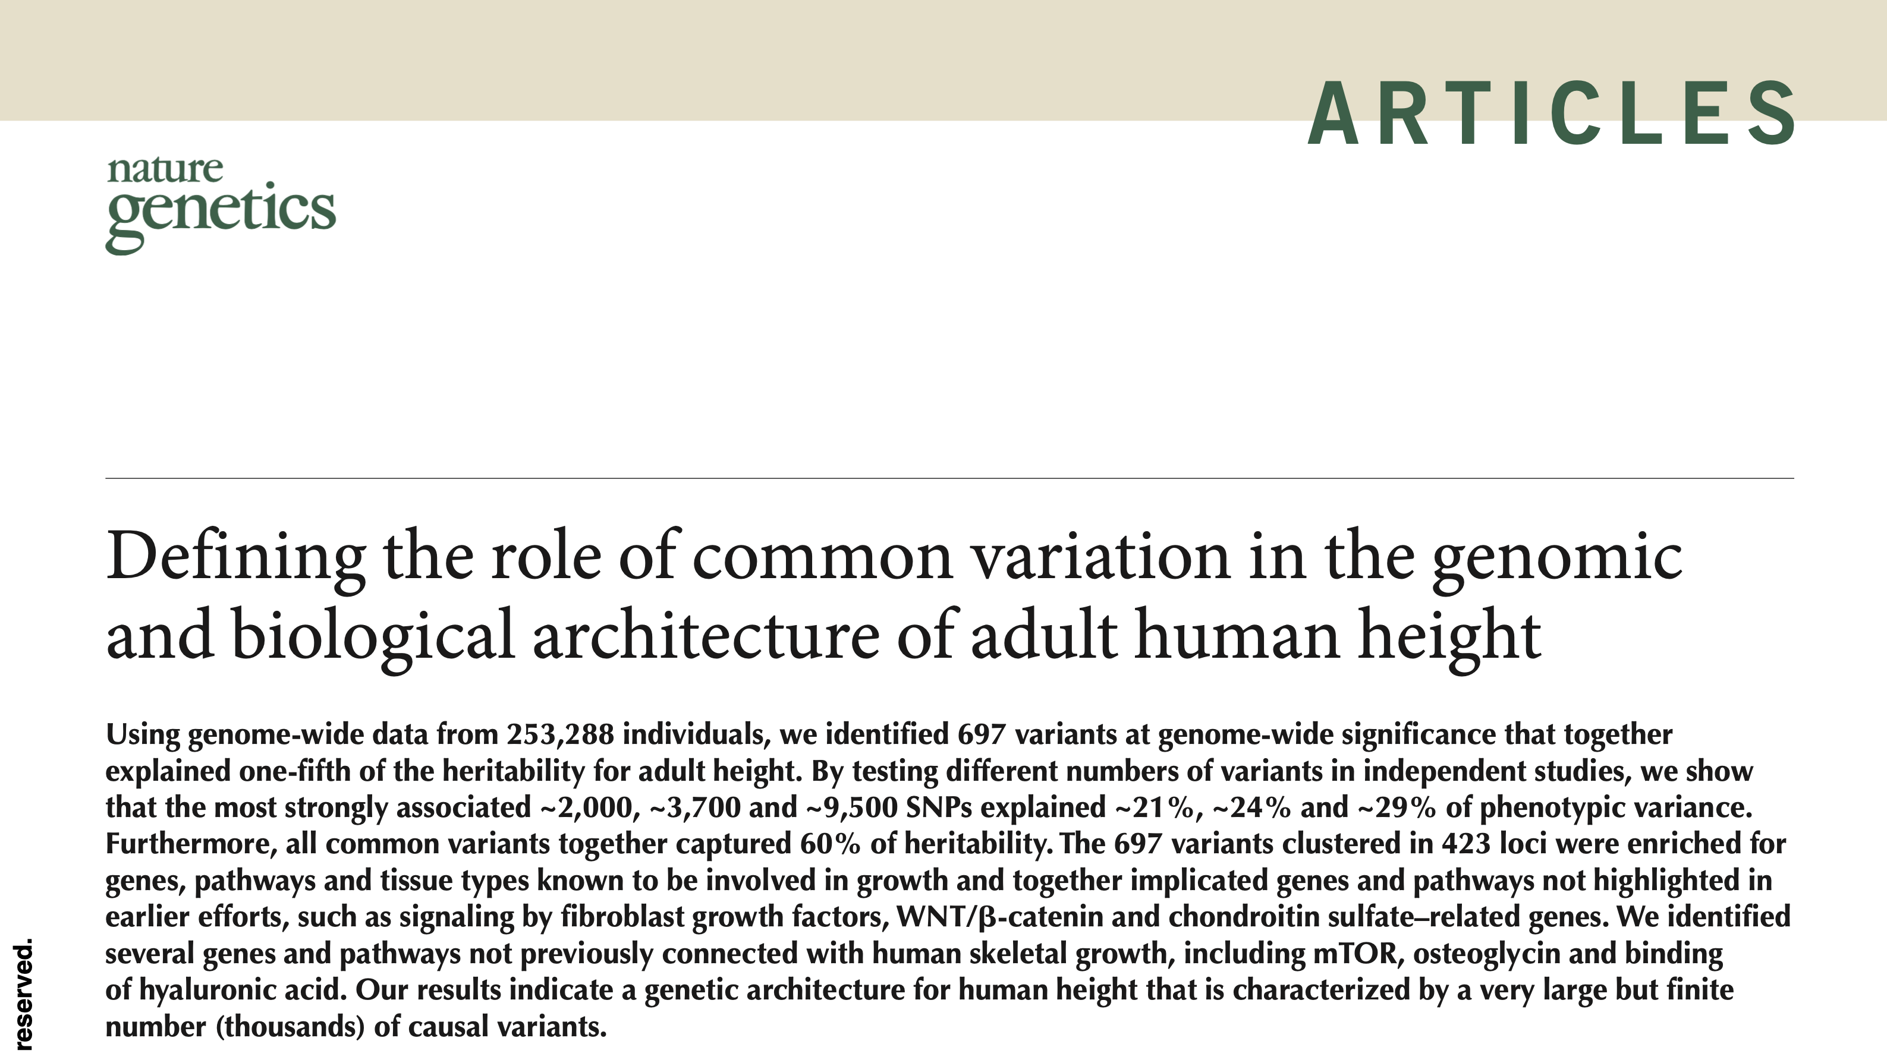
BMI and height GWAS
Clumped using r²<0.01, LD=10,000kb, to select:
79 SNPs associated with BMI
385 SNPs associated with height

Slide 33
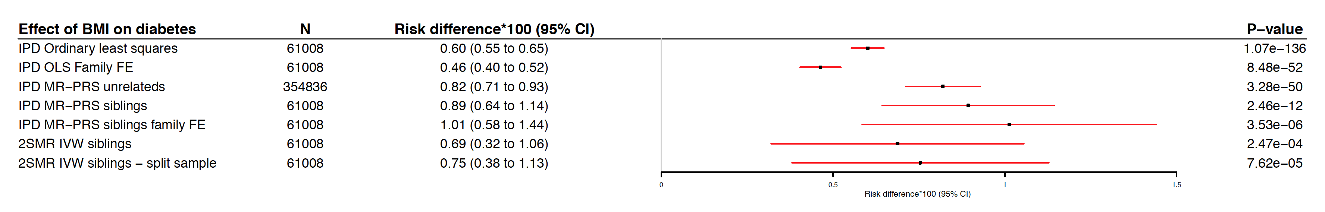
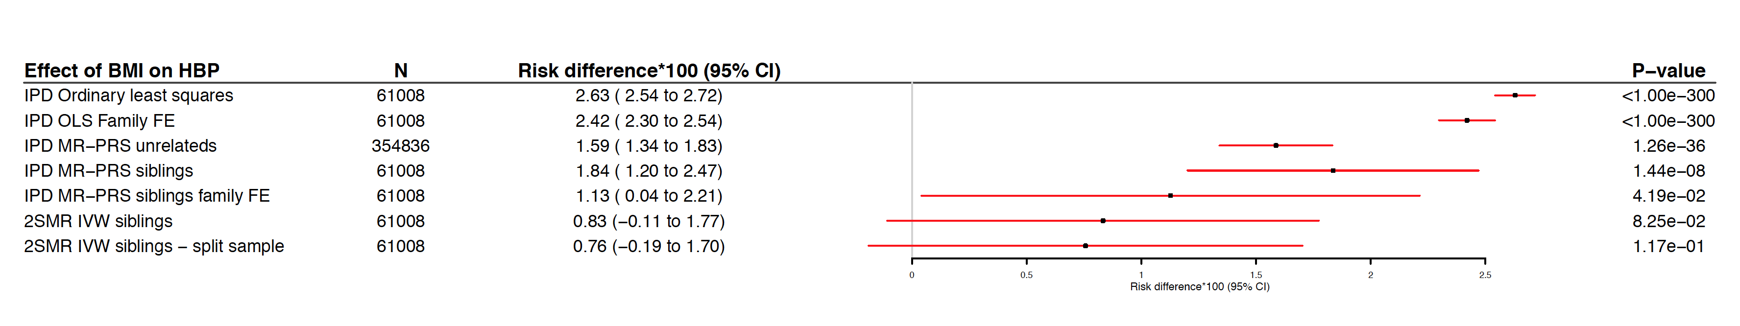
Results HUNT and UK Biobank
BMI > Diabetes
BMI > High blood pressure

Slide 34
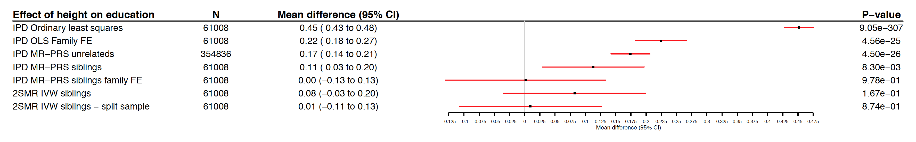
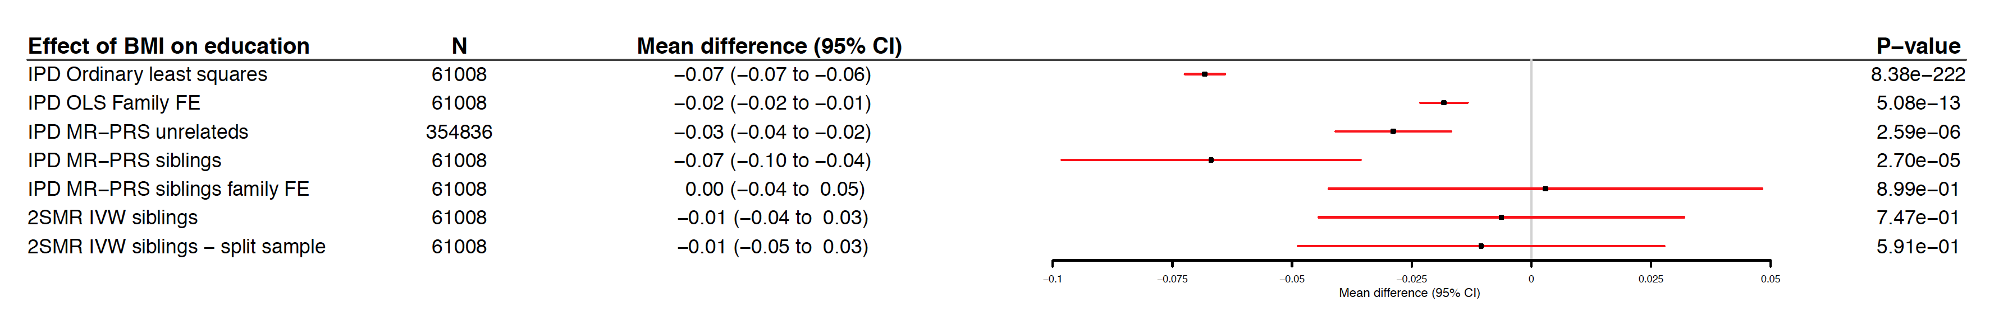
Results HUNT and UK Biobank
Height > Education
BMI > Education

Slide 35
Results 23andMe replication (n=222,368)
BMI > Diabetes
BMI > High blood pressure

Slide 36
Results 23andMe replication (n=222,368)
Height > Education
BMI > Education

Slide 37
Summary
Meta-analysis of HUNT, UKB and 23andMe
A 1kg/m² increase in BMI causes:
0.82 (95%CI: 0.55 to 1.06) additional cases of diabetes per 100
1.25 (95%CI: 0.90 to 1.59) additional cases of high blood pressure per 100
0.00 (95%CI: -0.018 to 0.018) additional years of education (i.e. <6.6 days)
10cm increase in height causes
0.00 (95%CI: -0.015 to 0.015) additional years of education (i.e. <5.5 days)
Very well powered estimates.
Confirm established adverse effects of higher BMI on health outcomes.
There is very unlikely to be meaningful causal effect of BMI or height on educational attainment.

Slide 38
Next steps: MR within families consortium
a. Within siblings GWAS
Running within sib and within families (trio) analysis to investigate the difference in genetic associations in unrelated individuals and related individuals across a range of traits and studies.
b. Assortative mating over time and across countries
Estimate assortative mating across time and in different countries. Will require data on spouses and phenotype data.
c. Non-inherited variants GWAS
Estimating dynastic and parent of origin effects using trios or duos. This approach would allow us to investigate the intergenerational transmission of a range of traits.
d. Assortative mating and obesity
There’s been several interesting papers that have suggested that the change in obesity, particularly the increase in the variance of BMI, could be explained by assortative mating. There have been some studies into this, but relatively few using molecular genetic data. The studies involved could provide new evidence about this hypothesis.

Slide 39
Next steps: MR within families consortium
Included studies:
Finnish Twin Cohort
Chinese National Twin Registry
Swedish Twin Registry
Texas Twin Project
QIMR
Murcia Twin Registry
NTR
Australian Mammographic Density Twins and Sisters Study
Italian Twin Registry
Minnesota Center for Twin and Family Research
Osaka University Twin Registry
Longitudinal Study of Aging Danish Twins
Generation Scotland
UK Biobank
TwinsUK
HUNT
Framingham Heart Study
ALSPAC
The Healthy Twin Study (Korea)
TEDS
QNTS
Exeter Family Study of Childhood Health (EFSOCH)
Mid-Atlantic twin reg
MoBa
Born in Bradford (duos)
Long Life Family Study
Inclusion criteria – relateds (duos, trios, siblings).

Slide 40
Within-families consortium
Collaborative consortium effort for projects using family data.
Includes family studies and large population biobanks (e.g. UK Biobank has ~20K sibling pairs).
Main project: Sibling GWAS of 30+ complex traits.
Fit conventional and within-family models for comparison.

Slide 41
Sibling GWAS
To date summary data on ~137,000 siblings, expect to reach 180,000+.
High coverage of phenotypes although sample sizes vary.
Study | Max number of siblings
UK Biobank | 40,210
HUNT | 38,549
Generation Scotland | 19,914
Netherlands Twin Registry | 4,708
FinnTwin | 8,810
TEDS | 4,224
China Kadoorie Biobank | 13,856
Aging Danish Twins | 1,172
Viking | 930
Orcades | 837
TwinsUK | 2,806
Australian Mammographic Study | 1,811
Total | 137,827

Slide 42
Genetic association estimates decrease
Phenotype | Number of SNPs | Shrinkage estimate in comparison of conventional and within-family models (95% C.I.)
Height | 385 | 9.0% (6.7%, 11.2%)
Educational attainment | 53 | 38.7% (23.1%, 54.3%)
Ever smoking | 92 | 17.5% (5.3%, 29.7%)

Slide 43
Evidence of heterogeneity across studies
e.g. Height variants
Study | N | GWS shrinkage estimate (95% C.I.)
UK Biobank | 40,068 | 13.1% (9.4%, 16.2%)
HUNT | 37,689 | 0.8% (-3.3%, 4.9%)
Generation Scotland | 19,904 | 12.4% (7.5%, 17.4%)
Meta-analysis | 121,719 | 9.0% (6.7, 11.2%)

Slide 44
Educational attainment more consistent
Study | N | GWS shrinkage estimate (95% C.I.)
UK Biobank | 39,531 | 48.1% (29.5%, 66.6%)
HUNT | 32,120 | 29.2% (-0.2%, 58.6%)
Generation Scotland | 19,589 | 56.2% (21.1%, 91.3%)
Meta-analysis | 104,316 | 38.7% (23.1%, 54.3%)

Slide 45
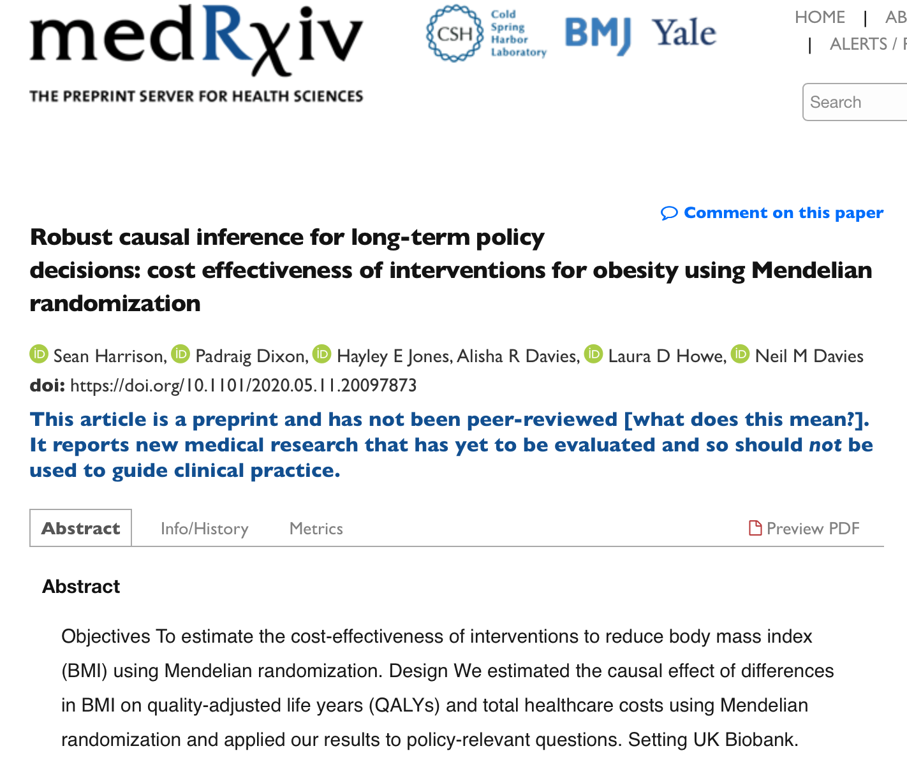
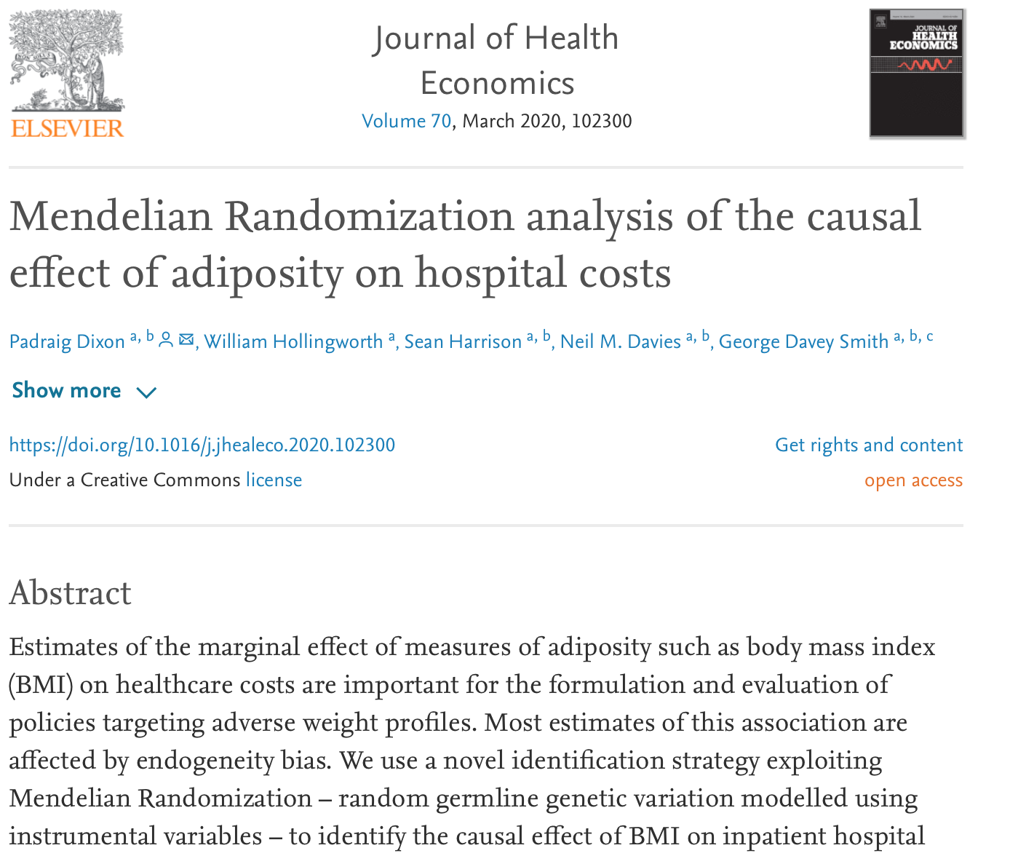
MR for Health Economics
No time, but may be of interest to health economists…

Slide 46
Conclusions
Familial effects can bias SNP-phenotype associations
These effects can bias genetic approaches such as Mendelian randomization.
We demonstrated how family structure can be used to control for these effects either using samples of siblings or mother-father-offspring trios.
However, estimates from within-family Mendelian randomization are less precise than estimates using unrelated individuals.
In samples from HUNT, UK Biobank studies and 23andMe, we found that the effects of height and BMI on educational attainment almost entirely attenuated after allowing for a family fixed effects, whereas the effects of BMI on the risk of diabetes and high blood pressure were similar when allowing for family effects.
MR
Davey Smith et al. 2003

Slide 47
Conclusions
While allowing for family fixed effects or using difference-in-difference estimators will account for dynastic effects or assortative mating, these methods will not address bias due to violations of the second Mendelian randomization assumption.
Use these estimators with the summary data methods (MR-Egger, weighted median and mode).
Any one study is likely to be underpowered to use both within family methods and pleiotropy robust methods.
Therefore, a consortium of family based studies was required, this gives sufficient power to use both within family and pleiotropy robust methods.
Currently running sibling GWAS in just under 200,000 siblings …. watch this space!
https://www.biorxiv.org/content/10.1101/602516v1

Slide 48
Acknowledgements – co-authors
Bristol/MRC IEU
Laurence Howe
George Davey Smith
Gib Hemani
Tim Morris
Amanda Hughes
Eleanor Sanderson
Sean Harrison
Yoonsu Cho
Laura Howe
University of Queensland
David Evans
University of Pelotas
Fernando Hartwig
23andMe Research Team
Karl Heilbron
Adam Auton
NTNU
Ben Brumpton
Gunnhild Åberge Vie
Johan Håkon Bjørngaard
Bjørn Olav Åsvold
Cristen Willer
Kristian Hveem
NIPH
Alexandra Havdahl
Vrije Universiteit Amsterdam
Dorret I Boomsma
Michel G Nivard
Oxford University
Frank Windmeijer
The University of Melbourne
John Hopper
Shuai Li
Virginia Commonwealth University
Michael Neale
Karolinska Institutet
Nancy L Pedersen
University of California Riverside
Chandra A Reynolds
University of Texas at Austin
Elliot M Tucker-Drob
Andrew Grotzinger
University of Virginia
Wei-Min Chen
University of Helsinki
Jaakko Kaprio

Slide 49
Acknowledgements – funding
The Medical Research Council (MRC) and the University of Bristol support the MRC Integrative Epidemiology Unit [MC_UU_12013/1, MC_UU_12013/9, MC_UU_00011/1]. NMD is supported by an Economics and Social Research Council (ESRC) Future Research Leaders grant [ES/N000757/1] and a Norwegian Research Council Grant number 295989. JHB was funded by the Norwegian Research Council with grant number 295989. DME is funded by a National Health and Medical Research Council Senior Research Fellowship (1137714). EMTD was supported by NIH grants R01AG054628 and R01HD083613, and by the Jacobs Foundation. LDH is supported by a Career Development Award from the UK Medical Research Council (MR/M020894/1). This work is part of a project entitled ‘social and economic consequences of health: causal inference methods and longitudinal, intergenerational data’, which is part of the Health Foundation’s Social and Economic Value of Health Research Programme (Award 807293). The Health Foundation is an independent charity committed to bringing about better health and health care for people in the UK. GAV is supported by a Norwegian Research Council grant code 250335. CAR receives support from the National Institutes of Health (NIH) including R01AG060470, R01AG059329, R01AG058068, R01AG018386, and R01AG046938. NLP receives funding from the National Institutes of Health Grants No. R01AG060470, R01AG059329. The Nord-Trøndelag Health Study (The HUNT Study) is a collaboration between HUNT Research Center (Faculty of Medicine and Health Sciences, NTNU, Norwegian University of Science and Technology), Nord-Trøndelag County Council, Central Norway Regional Health Authority, and the Norwegian Institute of Public Health. The K.G. Jebsen Center for Genetic Epidemiology is funded by Stiftelsen Kristian Gerhard Jebsen; Faculty of Medicine and Health Sciences, NTNU; The Liaison Committee for education, research and innovation in Central Norway; and the Joint Research Committee between St. Olavs Hospital and the Faculty of Medicine and Health Sciences, NTNU. The genotyping in HUNT was financed by the National Institute of Health (NIH); University of Michigan; The Research Council of Norway; The Liaison Committee for education, research and innovation in Central Norway; and the Joint Research Committee between St. Olavs Hospital and the Faculty of Medicine and Health Sciences, NTNU. JK has been supported by the Academy of Finland (grants 308248, 312073). RMF and RNB are supported by Sir Henry Dale Fellowship (Wellcome Trust and Royal Society grant: WT104150). GH is supported by the Wellcome Trust and Royal Society [208806/Z/17/Z]. AH was funded by the South-Eastern Norway Regional Health Authority, grants 2018059 and 2020022.

